Slide 1
Introduction to Git and GitHub
Brandon Chupp 2017

Slide 2
What is git?
Git is a version control system which tracks file changes. It is primarily used by programmers to manage source code.

Slide 3
Why use git?
Keep different versions of code
Restore old backups
Collaborate with multiple people on one piece of code

Slide 4
Getting Started
Download and install: https://git-scm.com/downloads
Run command in console window to verify it is installed:
$git --version
Now, we’ll set our username and email so we know who is making changes:
$ git config --global user.name “emustudent”
$ git config --global user.email “emu.student@emu.edu”

Slide 5
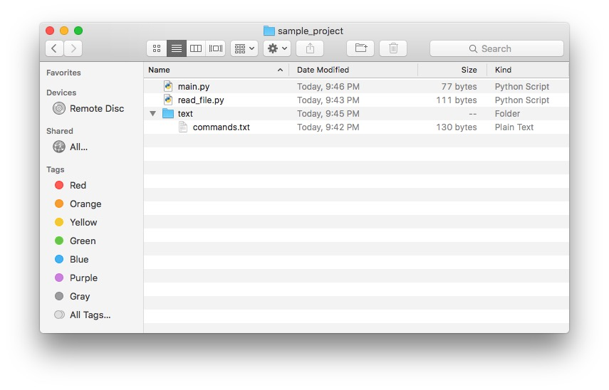
Start git in project folder:
$ git init

Slide 6
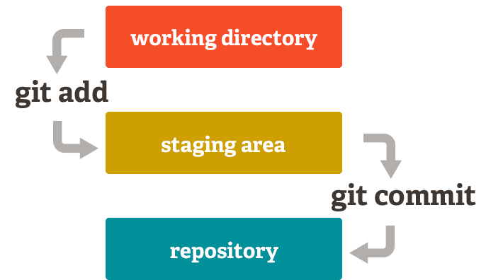

Slide 7
Add new files and commit
Add new files to be tracked by Git:
$ git add filename.txt
Note: To add all files in the current directory:
$ git add .
Commit changes made to files:
$ git commit –m “reason for changes here”

Slide 9
Make github account
Free software for students with .edu email address: https://education.github.com/pack
Make an account at https://github.com/

Slide 10
Setup new Repository
Make new public or private repository for your code
Add Github repository as remote:
$ git remote add origin git@github.com:emustudent/sampleproject.git
Now “push” your most recent changes
$ git push
Other steps…
Create .gitignore
$ git pull
$ git clone

