Slide 1
Identifying and Analyzing Stakeholders and Their Interests

Slide 2
What do we mean by stakeholders and their interests?
Stakeholders are those who may be affected by or have an effect on an effort.
They may also include those interested for academic, political, or philosophical reasons.
They can be divided into primary, secondary, and key stakeholders.
Their interests depend on how they affect or are affected by the effort, and can span a
broad range of categories.

Slide 3
Why identify and analyze stakeholders and their interests?
It puts more ideas on the table.
It includes varied perspectives from all sectors and elements of the community affected.
It gains buy-in and support for the effort from all stakeholders.
It’s fair to everyone.
It saves you from being blindsided
by concerns you didn’t know
about.

Slide 4
Why identify and analyze stakeholders and their interests?
It strengthens your position if there’s opposition.
It creates bridging social capital for the community
It increases the credibility of your organization.
It increases the chances for the success of your effort.

Slide 5
Who are potential stakeholders?
Primary stakeholders:
  Beneficiaries or targets of the effort.
Secondary stakeholders:
  Those directly involved with or responsible for beneficiaries or targets of the effort.
  Those whose jobs or lives might be affected by the process or results of the effort.
Key stakeholders:
  Government officials and policy makers.
  Those who can influence others.
  Those with an interest in the outcome
  of an effort.

Slide 6
When should you identify stakeholders?
In general, stakeholders and their interests should be identified and involved/addressed as early in the process of the development of the effort as possible.

Slide 7
How do you identify and analyze stakeholders and their interests?
Identify stakeholders by:
  Brainstorming.
  Collecting categories and names from informants in the community.
  Consulting with organizations that either are or have been involved in similar efforts, or that work with the population or in the area of concern.
  Getting more ideas from stakeholders as you identify them.
  If appropriate, advertising.

Slide 8
Identify stakeholder Interests
Discover and try to understand stakeholder interests by asking them what’s important to them.

Slide 9
Stakeholder Analysis
Promoters have both great interest in the effort and the power to help make it successful (or to derail it). These are key players; keep them in view!
Defenders have a vested interest and can voice their support in the community, but have little actual power to influence the effort in any way. Keep them informed.
Latents have no particular interest or involvement in the effort, but have the power to influence it greatly if they become interested. Keep them satisfied.
Apathetics have little interest and little power, and may not even know the effort exists. Keep from
focusing on them.

Slide 10
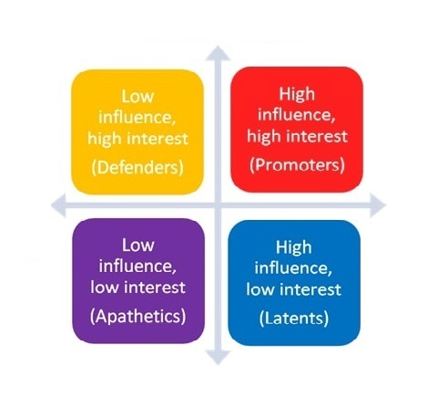
Apply stakeholder analysis: stakeholder mapping
Level of Interest
Influence

Slide 11
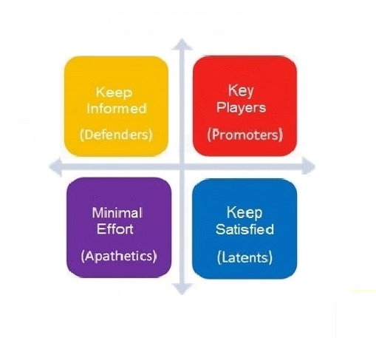
Apply stakeholder analysis: recommended focus
Level of Interest
Influence

Slide 12
Principles for Stakeholder Management
Treat them with respect.
Provide whatever information, training, mentoring, and/or other support they need to stay involved.
Find jobs for them to do that catch their interest and use their talents.
Maintain their enthusiasm with praise, celebrations, small tokens of appreciation, and continual reminders of the effort’s accomplishments.
Engage them in decision-making.
Employ them in the conception, planning, implementation, and evaluation of the effort from its beginning.
In the case of those who start with little power or influence, help them learn how to gain and exercise influence
by working together and developing their
personal, critical thinking, and political skills.

Slide 13
Evaluate Stakeholder involvement
  What could you have done to better identify stakeholders?
  Which strategies worked best to involve different populations and groups?
  How successful were you in keeping people involved?
  Did you provide any training or other support? Was it helpful? How could it have been improved?
  Did your stakeholder analysis and management efforts have the desired effect? Were they helpful?
  Did stakeholder involvement improve the
  work, effectiveness, and/or political and
  community support of the effort?

Slide 14
Sustain Stakeholder Involvement
Keep at it for the long term
Maintain stakeholders’ and supporters’ motivation, keep them informed, and continue to find meaningful work for them to do.
New stakeholders may need to be brought in as time goes on.
Although some people may cease to be actual stakeholders, they may retain an interest in the effort and you should therefore continue to include them.
Understanding and engaging stakeholders can be tremendously helpful to your effort, but only if it results in their ownership of it and long-term
commitment to it. And that depends on
your continuing attention.

