Slide 1
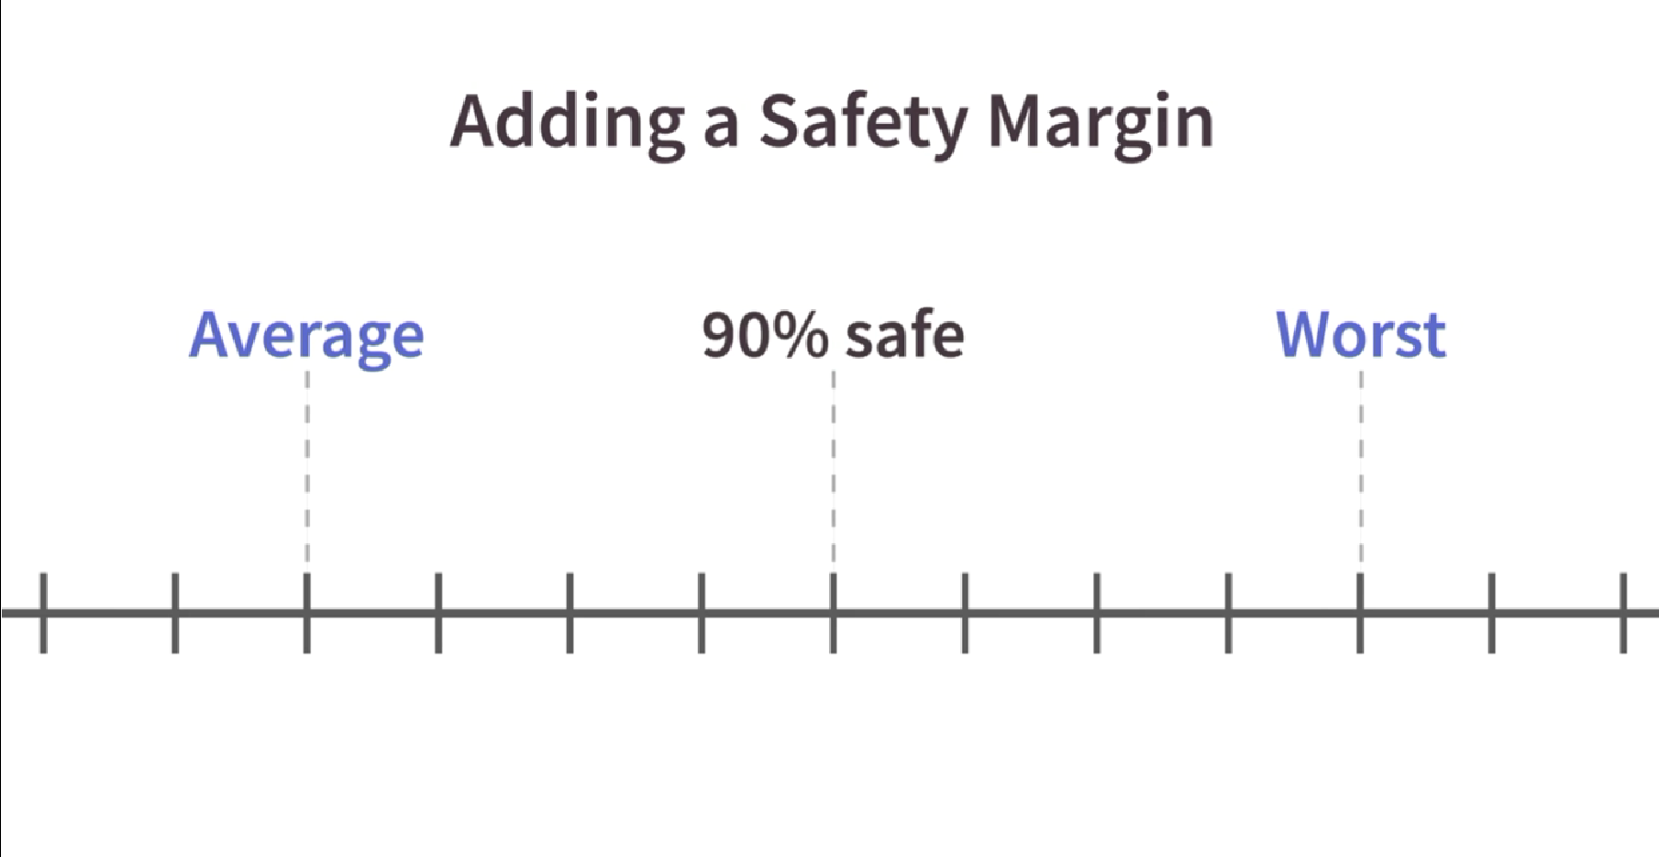
Adding Contingency
The 90% Rule

Slide 2
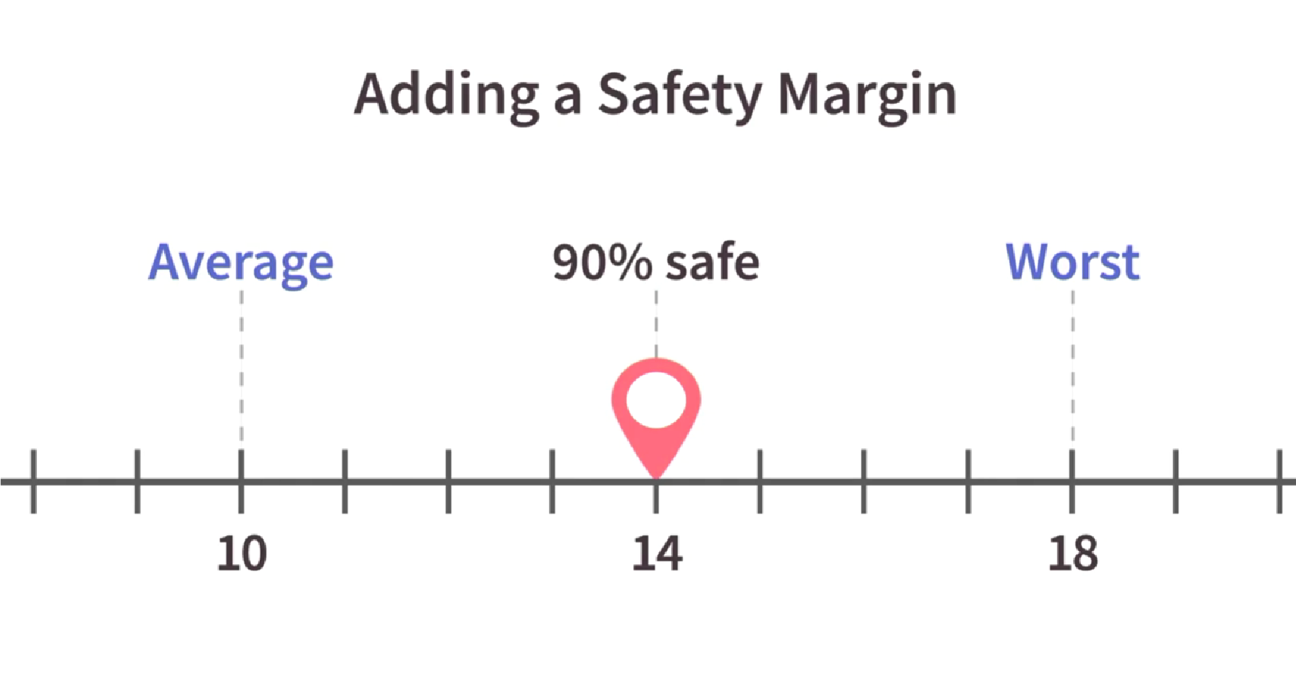
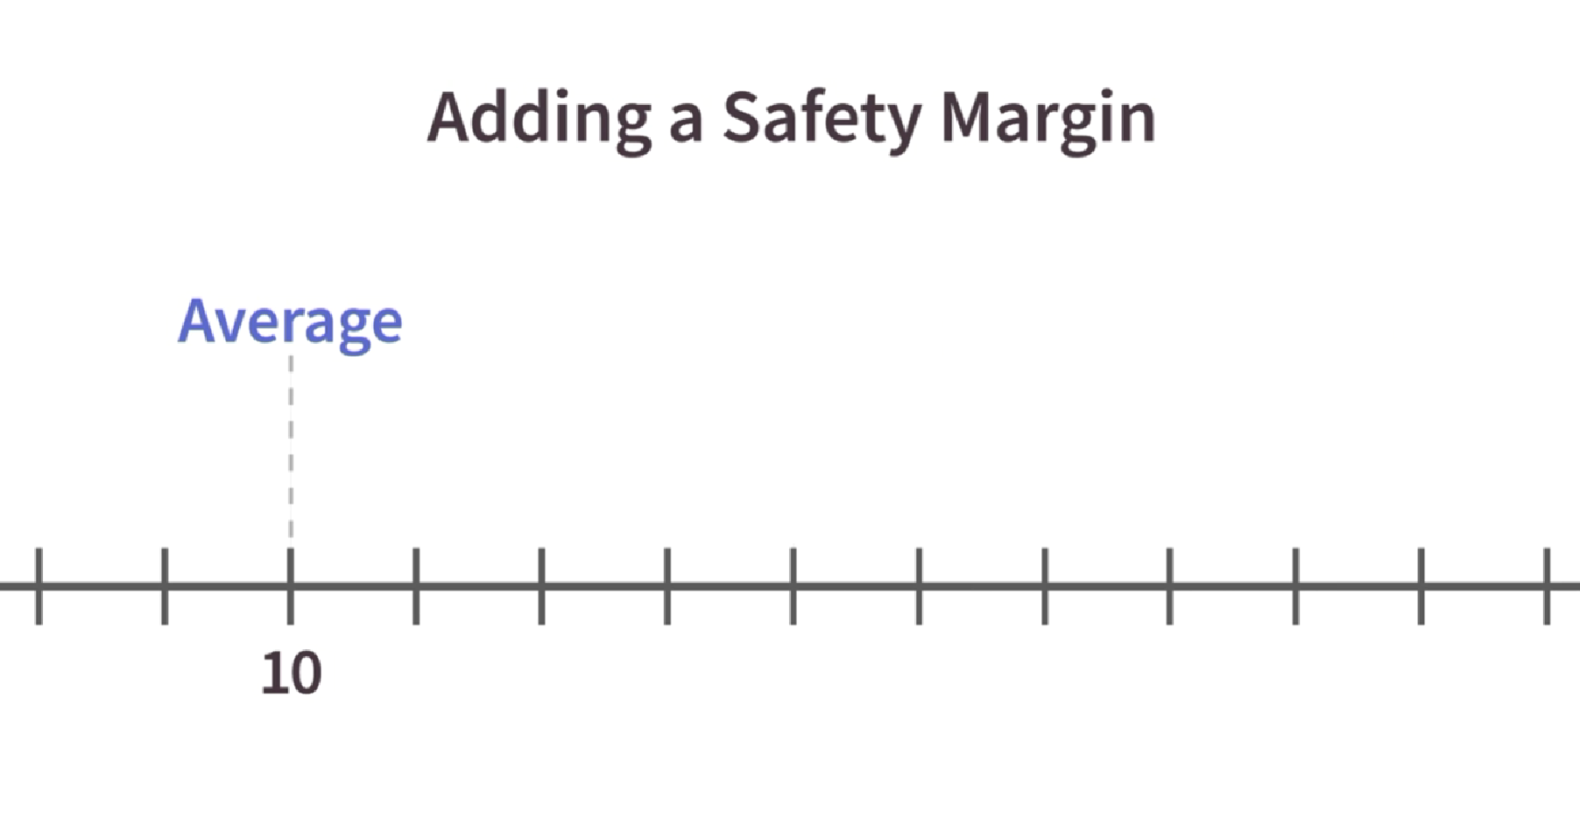
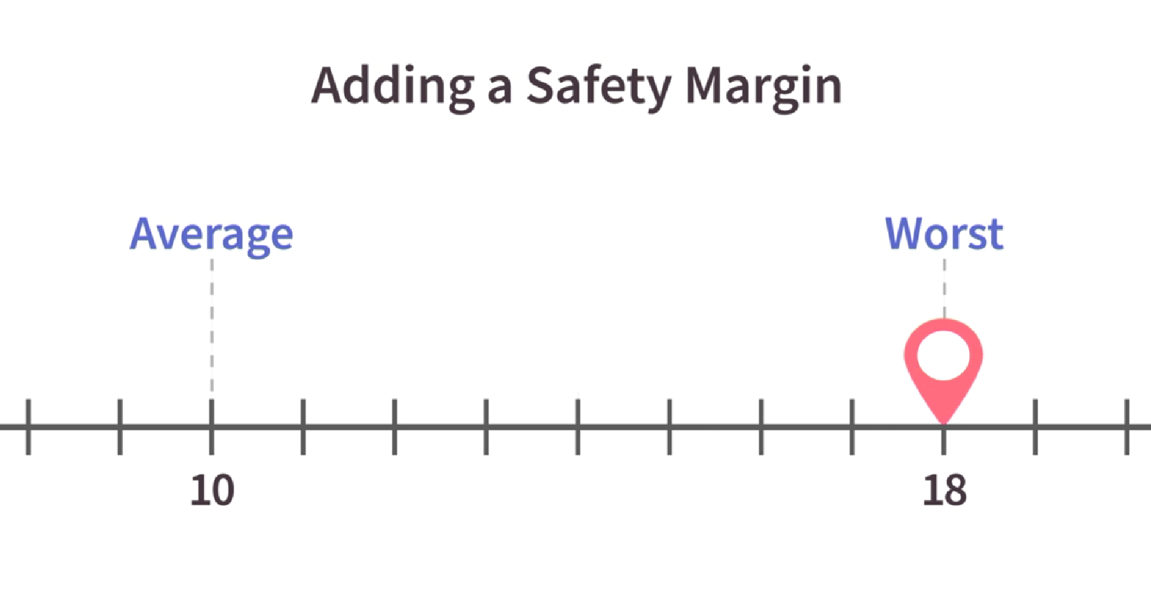
Adding Contingency
The 90% Rule
Notes:
If you estimate that your project will take 10 weeks, but then you calculate that the worst case scenario would add another 8 weeks.

Slide 3
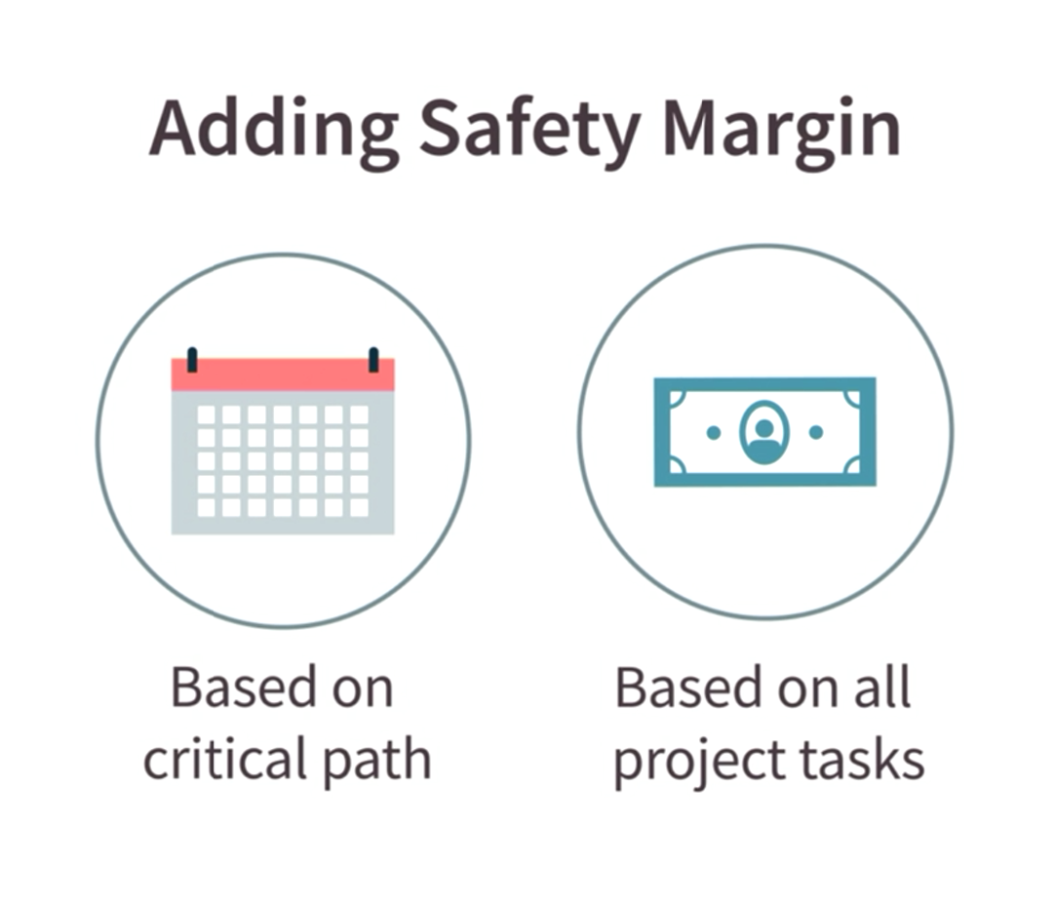
Adding Contingency
Time and Money
Notes:
We will do time contingency in this lesson – later we will do financial contingency. In time contingency, you only need to build in safety margins for the critical task. We will see later that, for financial contingency, we need to build in safety margins for all project tasks.

Slide 4
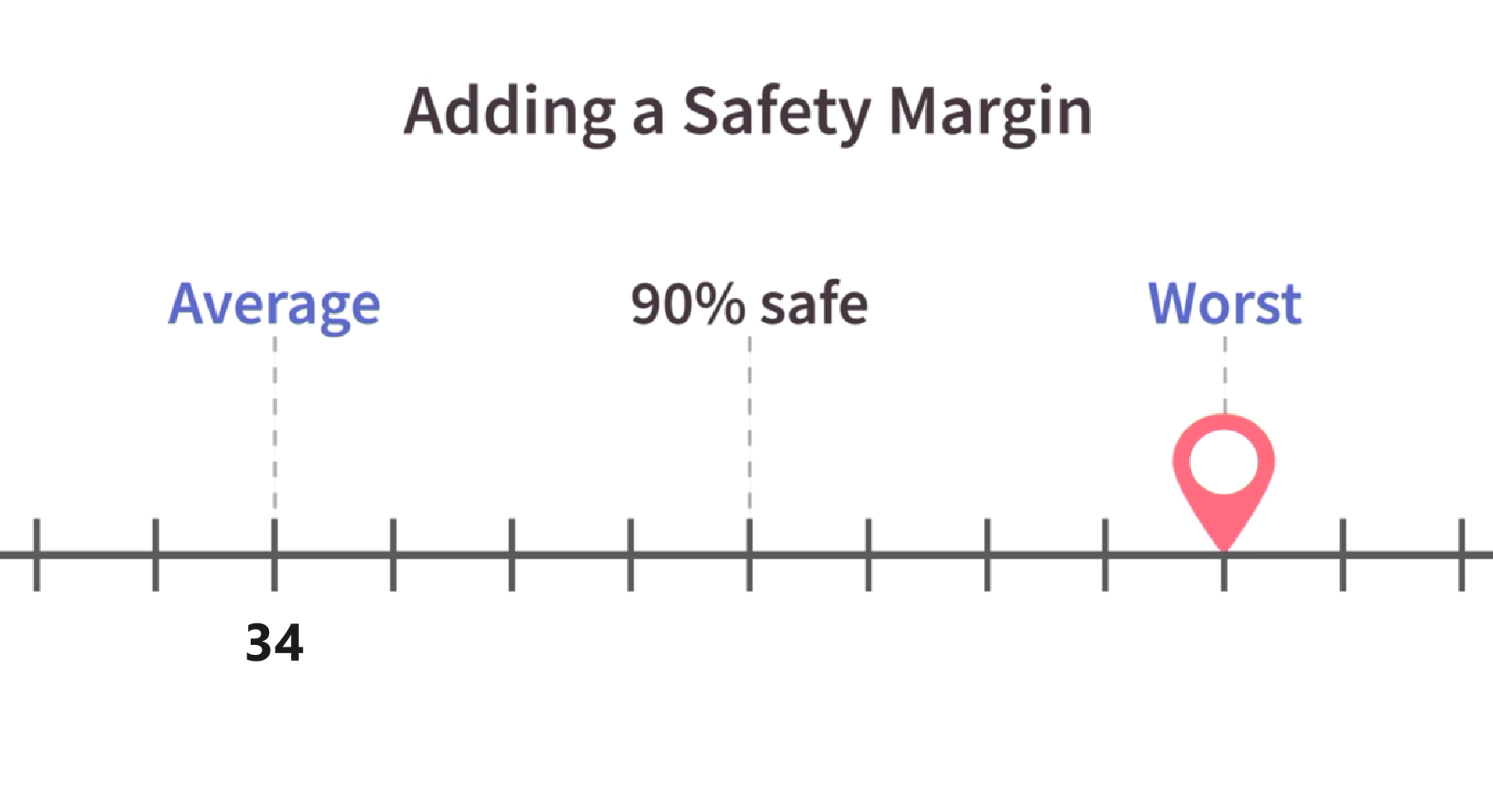
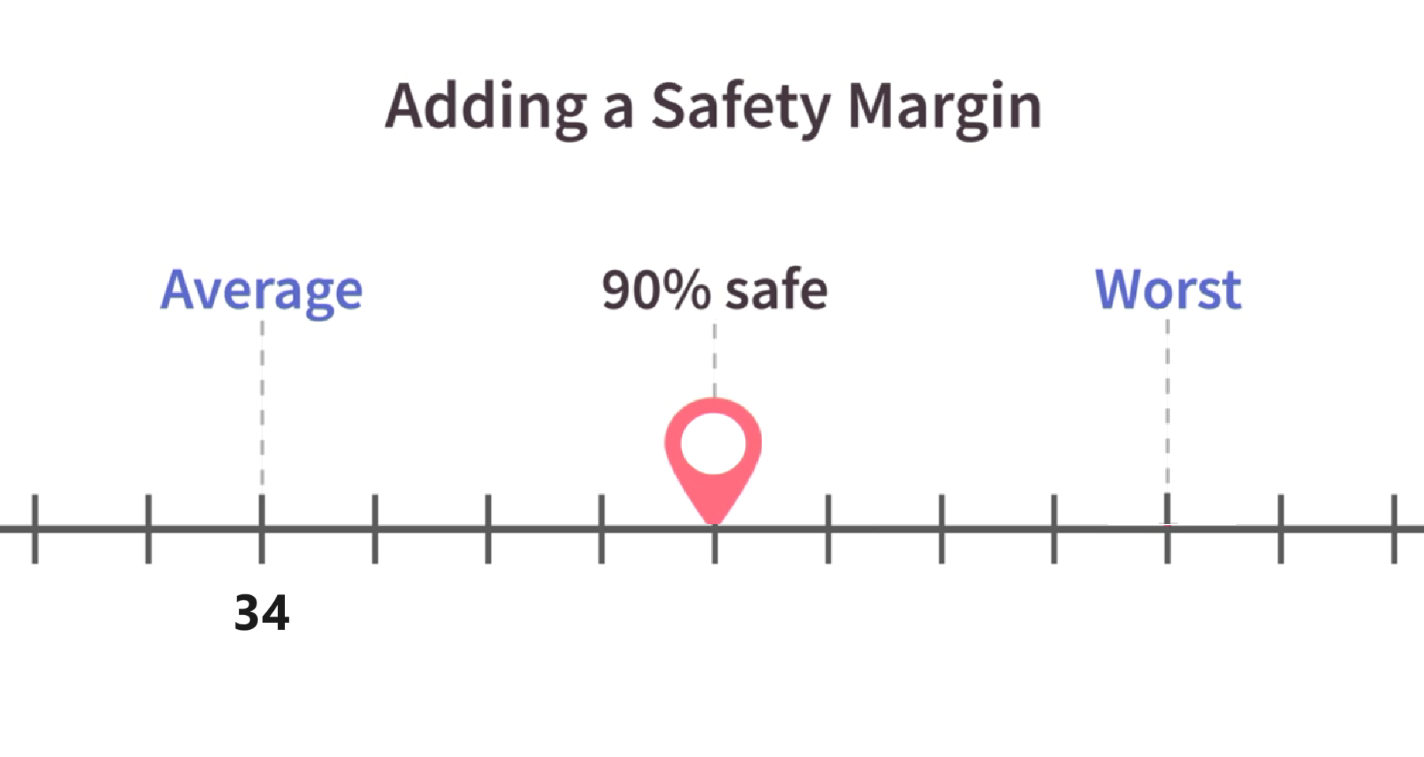
Adding Contingency
Our In-Class Project
34 + 9 = 43
34 + 18 = 52
Notes:
If we add 9 weeks to our critical path, that means we should have a 90% success rate. Thus, our critical path now needs to extend over a period of 43 works (as opposed to 34 weeks.)
So, let’s distribute these 9 weeks throughout our critical path:
(4+1=5) [Choose Location]
+
(10+3=13) [Get Permit]
+
(10+2=12) [Purchase Site]
+
(8+2=10) [Modify Building]
+
(2+1+3) [Install Furniture]
or
5 +13+12+10+3=43

Slide 5
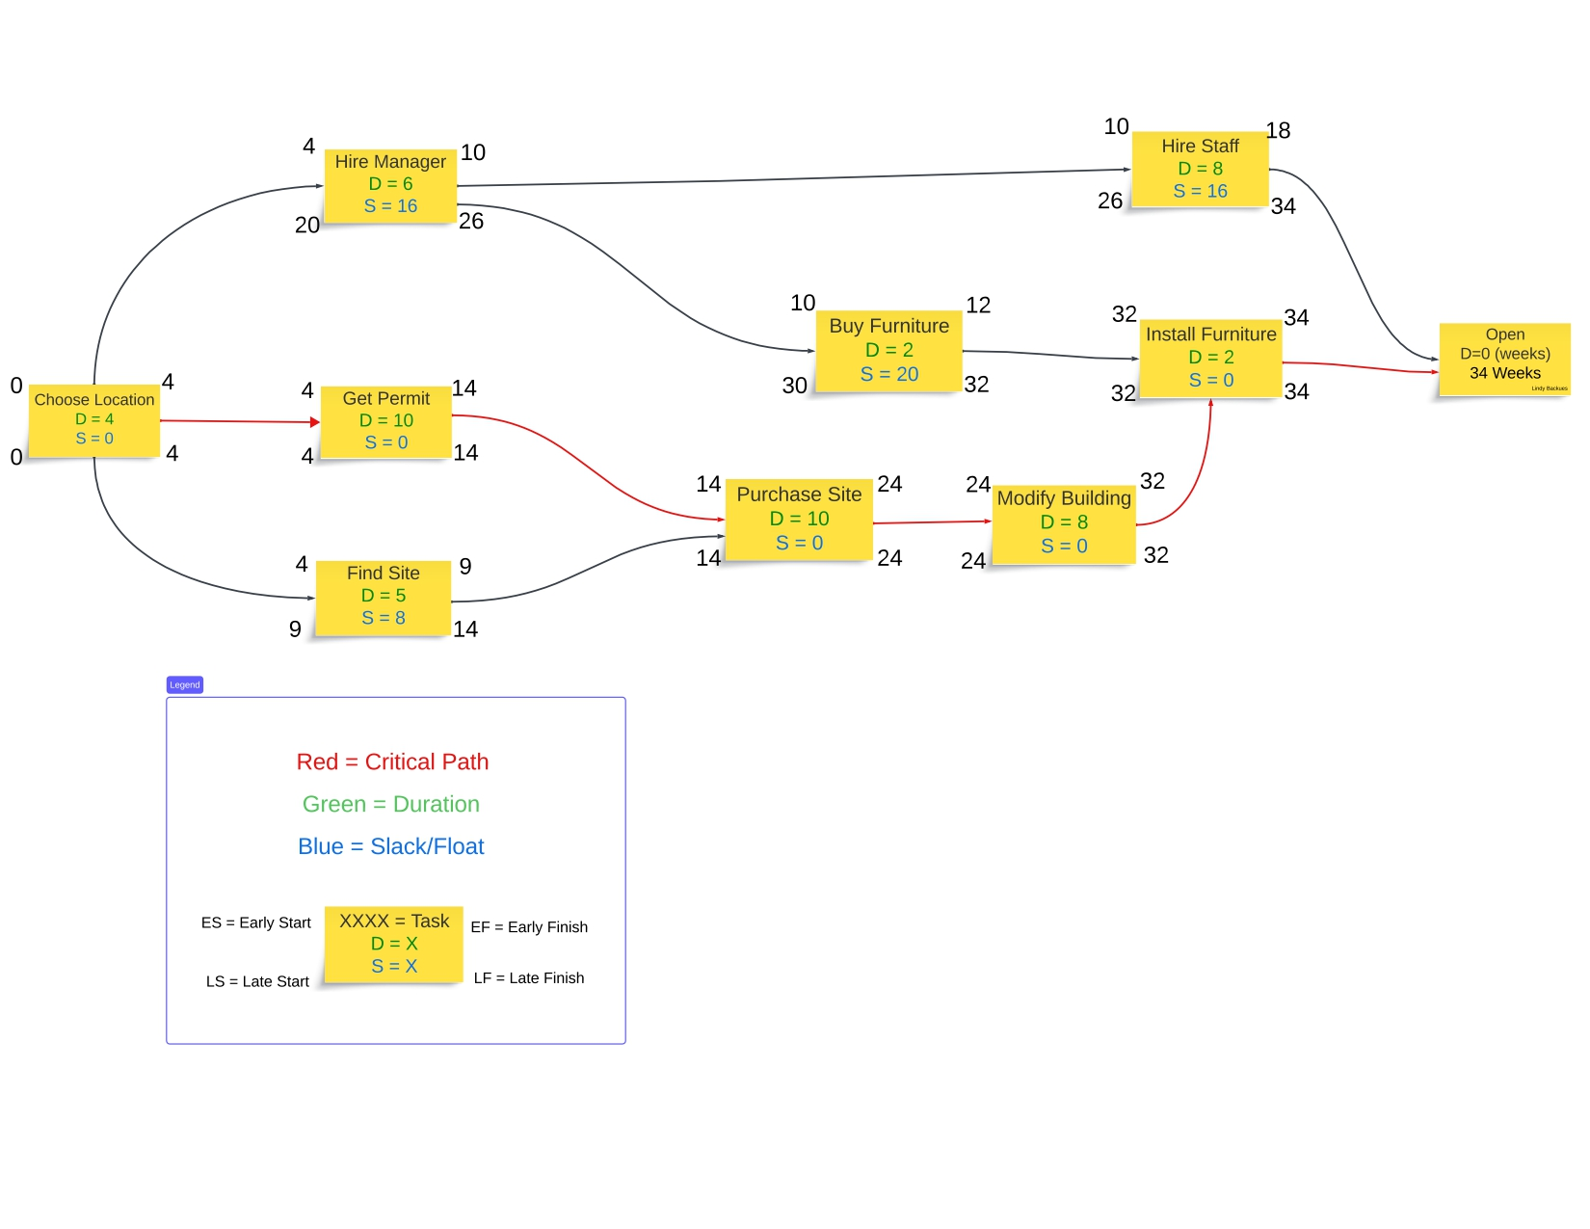
Adding Contingency
Not this!!!
Notes:
(4+1=5) [Choose Location]
+
(10+3=13) [Get Permit]
+
(10+2=12) [Purchase Site]
+
(8+2=10) [Modify Building]
+
(2+1+3) [Install Furniture]
or
5 +13+12+10+3=43

Slide 6
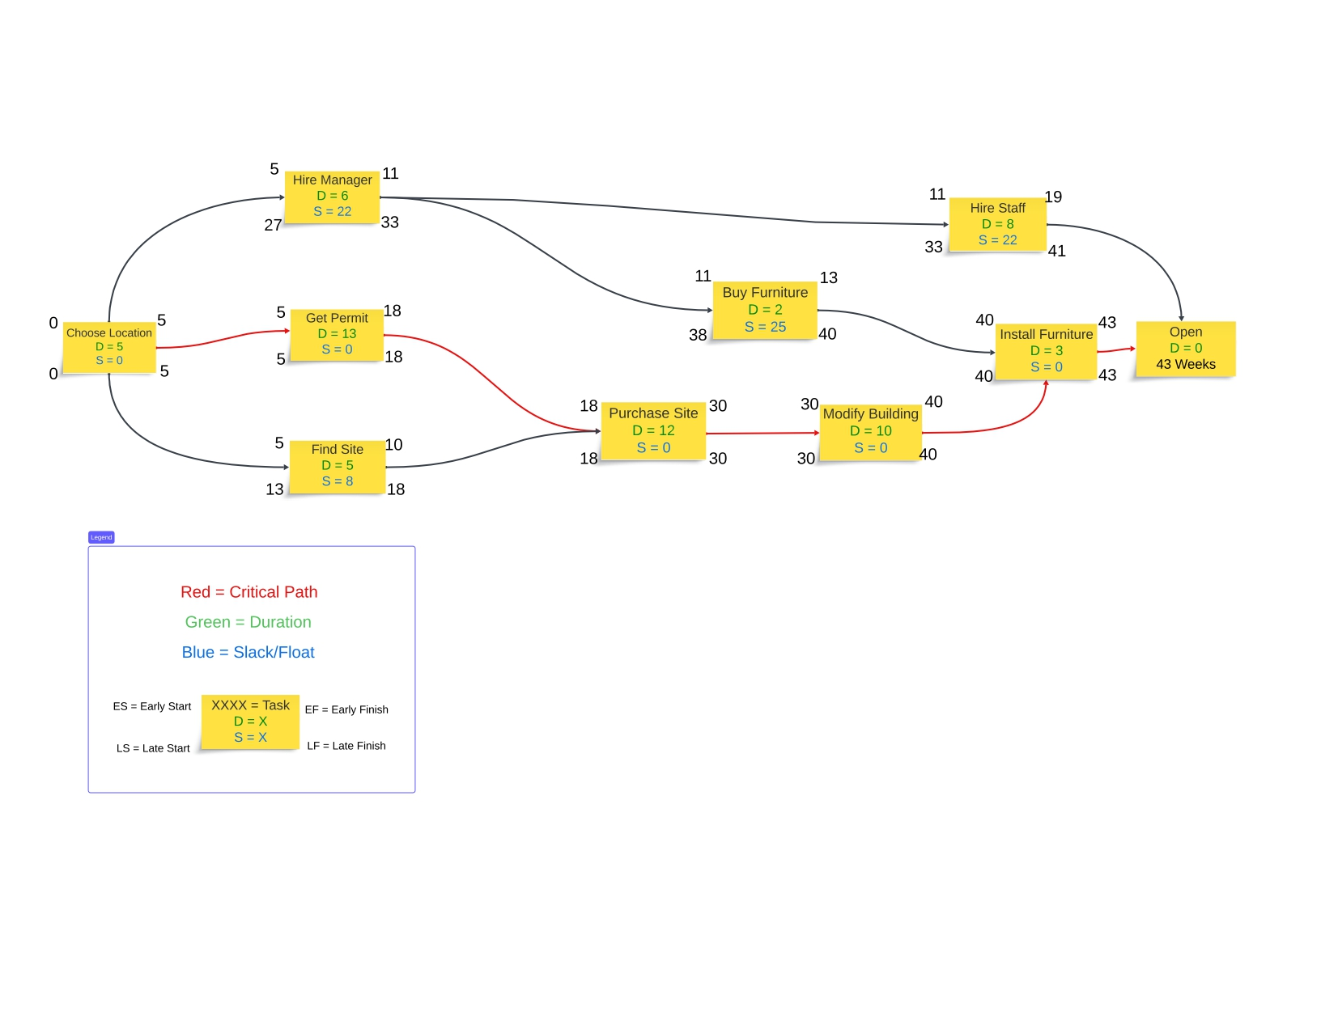
Adding Contingency
Instead, this!
Notes:
(4+1=5) [Choose Location]
+
(10+3=13) [Get Permit]
+
(10+2=12) [Purchase Site]
+
(8+2=10) [Modify Building]
+
(2+1+3) [Install Furniture]
or
5 +13+12+10+3=43

