Slide 1
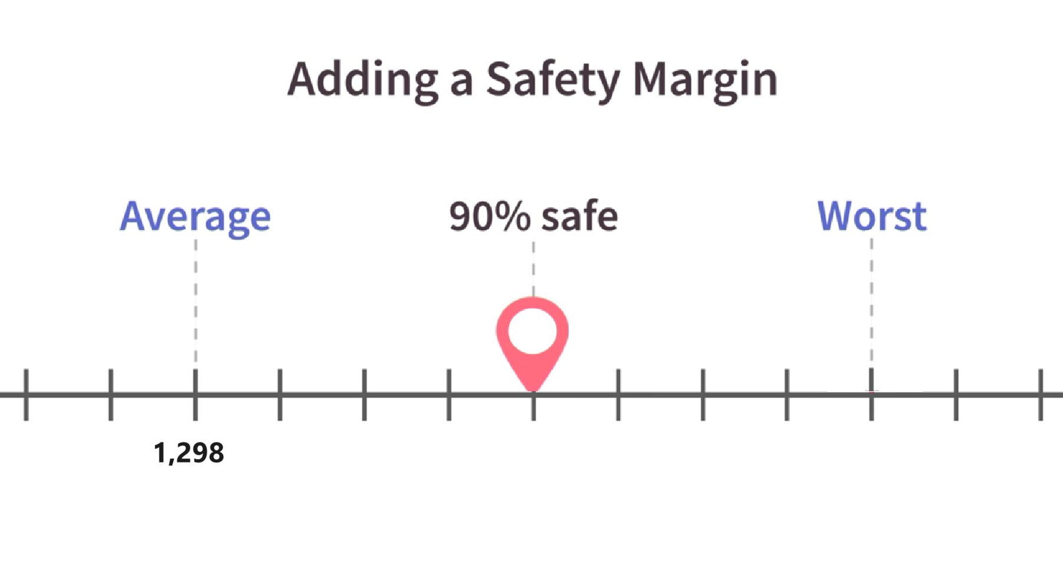
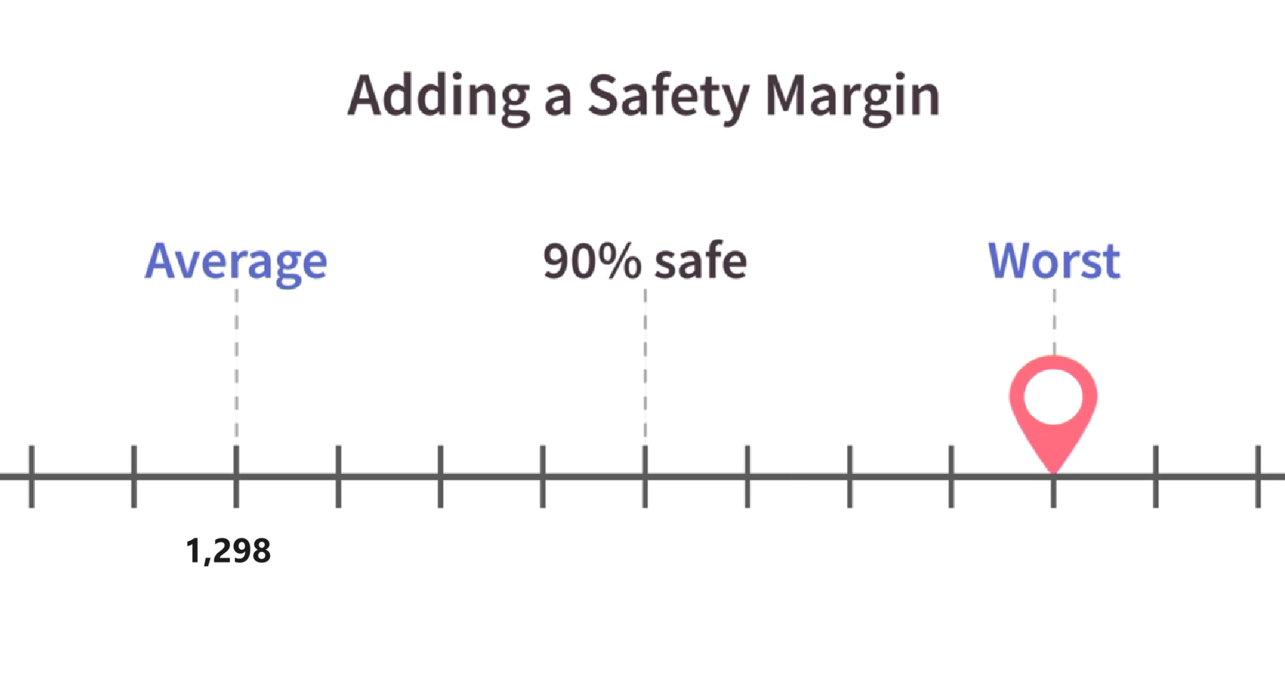
Adding Financial Contingency
Our In-Class Project
1,298 + 318 = 1,616
1,298 + 636 = 1,929
Notes:
As was the case when we added a safety margin to our critical path, if we add $318,000 to our project finance needs, that means we should have a 90% success rate of coming in on budget. Thus, funding needs must now be $1,616,000 (as opposed to $1,298,000.)
I have peppered the additional $318,000 throughout the steps of our project.

